Slide 1
Deep Reinforcement Learning (DRL) Framework for Reservoir Management
Shubhendu Singh

Slide 2
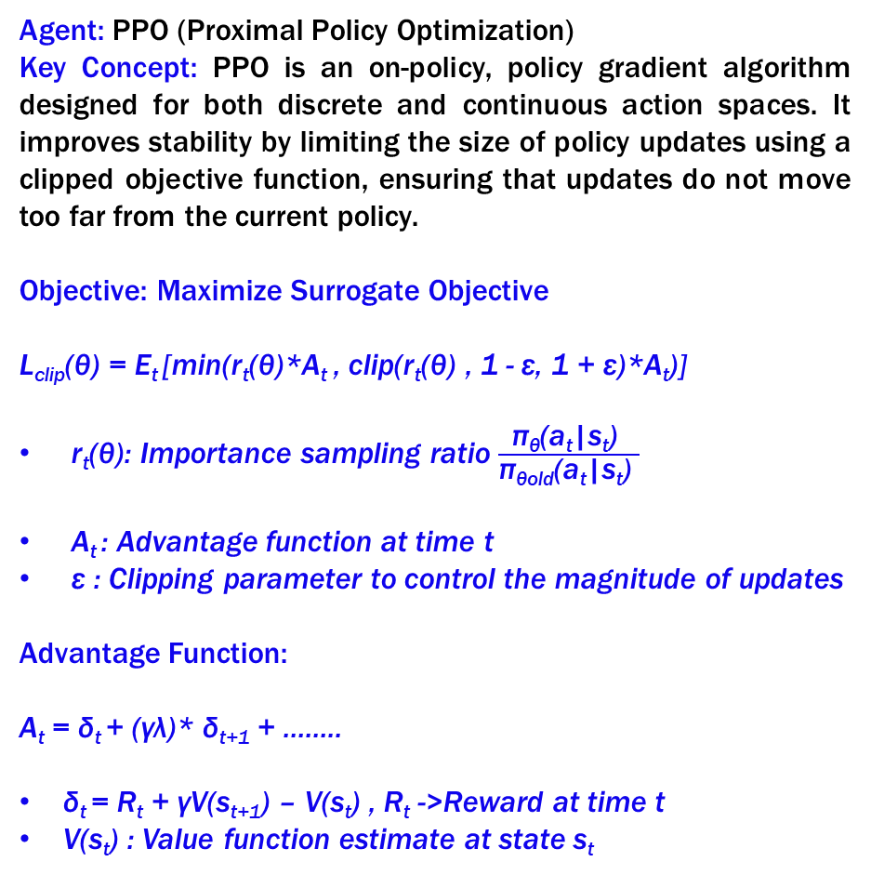
Agents
Agent: TD3 (Twin Delayed Deep Deterministic Policy Gradient)
Key Concept: TD3 is an off-policy, actor-critic algorithm designed for continuous action spaces. It addresses common challenges in deep reinforcement learning, such as value overestimation, by using two Q-functions and several enhancements for more stable learning.
Objective: Maximize Expected Return
J(θ) = E_{t} [r_{t} + γ*Q(s_{t+1} , π_{θ}(s_{t+1}))]
Q₁(s,a): Q-function for state-action pair (s,a)
π_{θ}: Policy network parametrized by θ
r_{t}: Reward at time t
γ: Discount factor
θ: Parameters of the policy
Loss Function:
L(θ) = E_{t}[(Q₁(s_{t},a_{t}) – (r_{t}+ γ*Q_{target}))²]
Q_{target}: Target Q-value computed from delayed target networks
Agent: PPO (Proximal Policy Optimization)
Key Concept: PPO is an on-policy, policy gradient algorithm designed for both discrete and continuous action spaces. It improves stability by limiting the size of policy updates using a clipped objective function, ensuring that updates do not move too far from the current policy.
Objective: Maximize Surrogate Objective
L_{clip}(θ) = E_{t} [min(r_{t}(θ)*A_{t} , clip(r_{t}(θ) , 1 - ε, 1 + ε)*A_{t})]
r_{t}(θ): Importance sampling ratio $\frac{\text{π}\text{θ}\text{(}\text{at}\text{|}\text{st}\text{)} }{\text{π}\text{θ}\text{old}\text{(}\text{at}\text{|}\text{st}\text{)} }$
A_{t} : Advantage function at time t
ε : Clipping parameter to control the magnitude of updates
Advantage Function:
A_{t} = δ_{t} + (γλ)* δ_{t+1} + ……..
δ_{t} = R_{t} + γV(s_{t+1}) – V(s_{t}) , R_{t} ->Reward at time t
V(s_{t}) : Value function estimate at state s_{t}

Slide 3
Comparative Findings: PPO, TD3, SAC Agents (MSE for Scaled Values)
Mean Squared Error (MSE) | Reward # 1 (Non-linear) | Reward # 2 ( Proximity to target) | Reward # 3 (Penalty for large changes in release, look back period)
PPO | 0.043231 | 0.034 | -
SAC | - | - | 0.01558
TD3 | - | 0.01685 | -
TD3 (1 day look back) | - | - | 0.01435
TD3 (3 day look back) | - | - | 0.01027
TD3 ( 7 day look back) | - | - | 0.01279

Slide 4
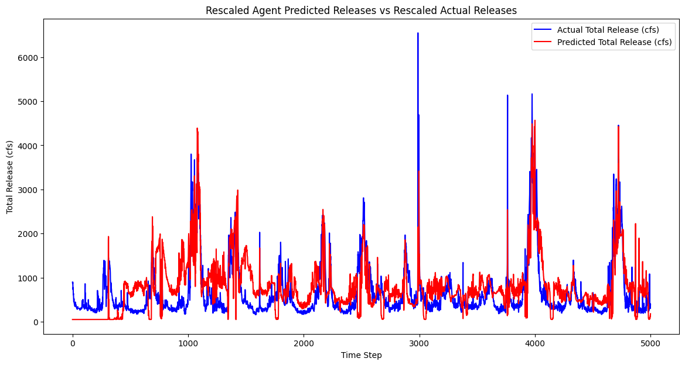
TD3 Agent: Performance when learning human behavior
Mean Squared Error (MSE) : 0.01027

Slide 5
TD3 Optimization Problem
# Define reservoir release and storage limits
navajo_min_release = 250 cfs, navajo_max_release = 5000 cfs
min_storage_af = 500000 AF, max_storage_af = 1900000 AF
# Update storage with current release, inflow, and evaporation, ensuring non-negative storage
self.current_storage = max(0, self.current_storage - release_af + inflow_af - evaporation_af)
# Enforce maximum and minimum storage limits
self.current_storage = min(max(self.current_storage, min_storage_af), max_storage_af)
# Reward based on release within acceptable range and storage limits
release_reward = -0.1 * abs(release_af - np.clip(release_af, navajo_min_release, navajo_max_release))
# Additional reward for keeping storage within range
if min_storage_af <= self.current_storage <= max_storage_af:
storage_reward = 1 - (abs(self.current_storage - (min_storage_af + max_storage_af) / 2) / (max_storage_af - min_storage_af))
else:
storage_reward = -2.0 # penalty for out-of-bound storage
# Total reward
reward = release_reward + storage_reward

Slide 6
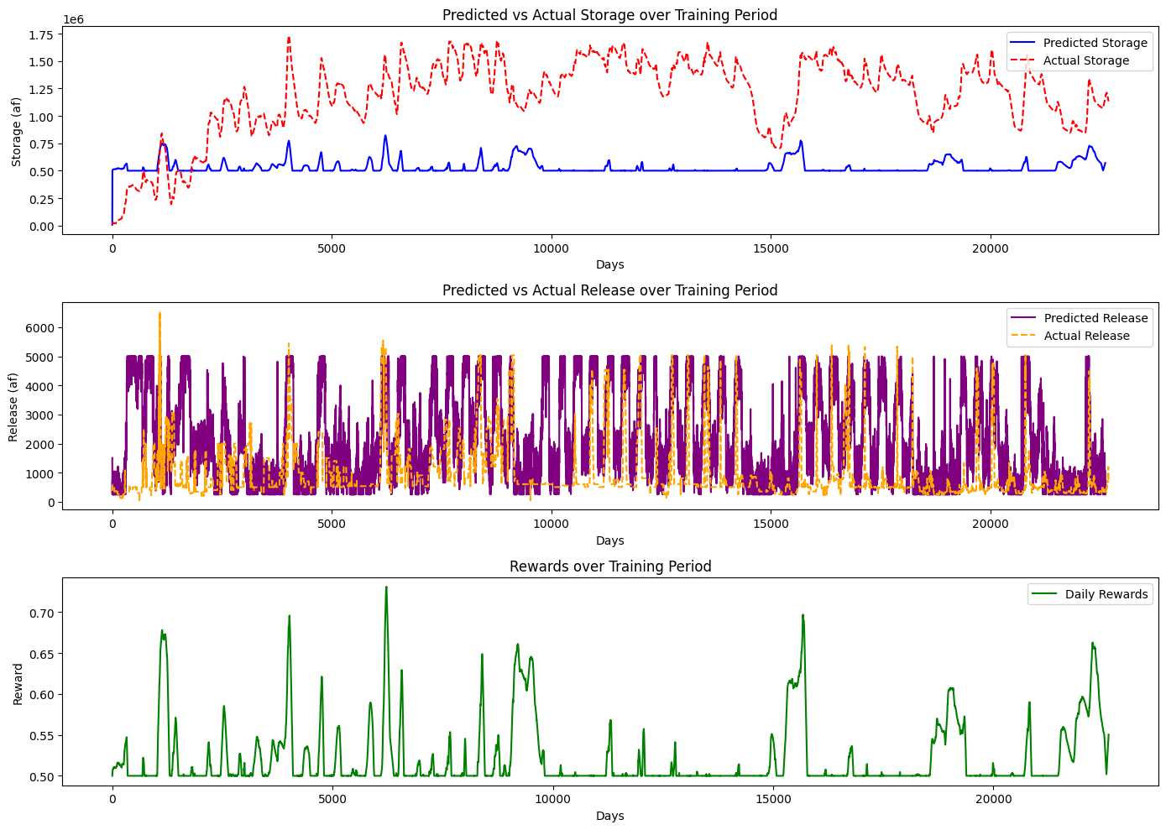
TD3 Optimization Problem

Slide 7
TD3 Optimization Problem
# Define reservoir release and storage limits
navajo_min_release = 250cfs, navajo_max_release = 5000cfs
min_storage_af = 500000 AF, max_storage_af = 1900000 AF, Target_storage= (min_storage_af+ max_storage_af )/2
# Update storage with current release, inflow, and evaporation, ensuring non-negative storage
self.current_storage = max(0, self.current_storage - release_af + inflow_af - evaporation_af)
# Enforce maximum and minimum storage limits
self.current_storage = min(max(self.current_storage, min_storage_af), max_storage_af)
# Reward based on release within acceptable range and storage limits
release_reward = -0.1 * abs(release_af - np.clip(release_af, navajo_min_release, navajo_max_release))
storage_target_reward = 1 - abs(self.current_storage - target_storage_af) / (max_storage_af - min_storage_af)
# Additional penalty for storage falling below minimum
if min_storage_af <= self.current_storage <= max_storage_af:
storage_penalty = -1.5
else:
storage_penalty = 0
# Total reward
reward = 0.6 * release_reward + 1.2 * storage_target_reward + storage_penalty

Slide 8
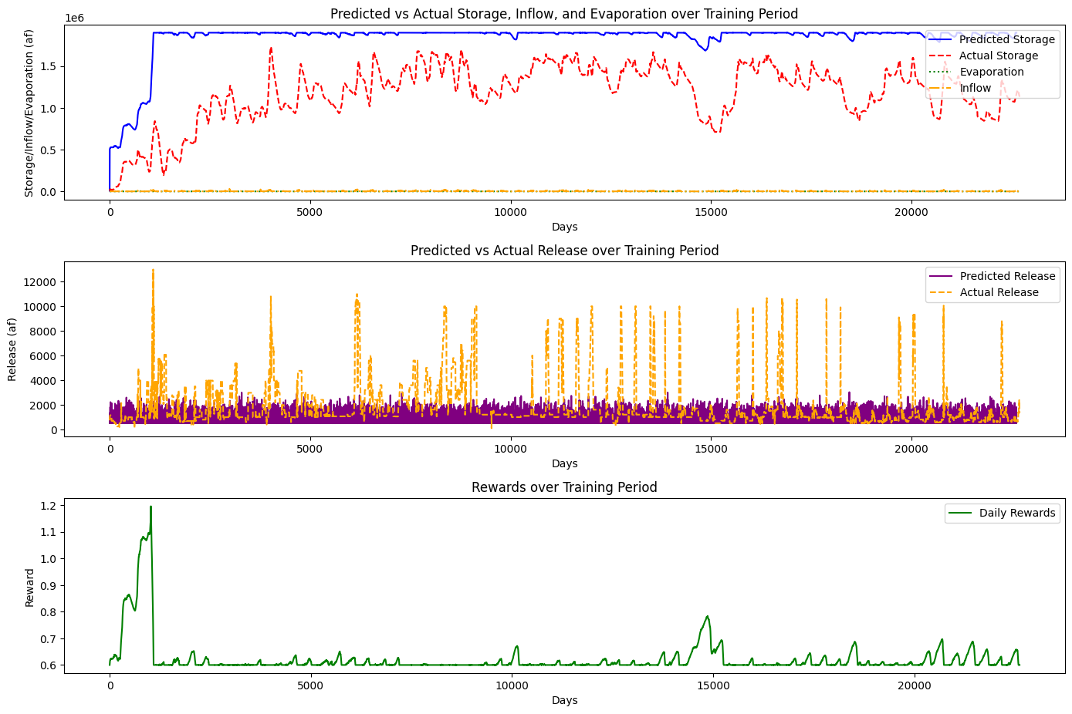
TD3 Optimization Problem

Slide 9
TD3 Optimization Problem
# Define reservoir release and storage limits
navajo_min_release = 250cfs, navajo_max_release = 5000cfs
min_storage_af = 500000 AF, max_storage_af = 1900000 AF, Target_storage= (min_storage_af+ max_storage_af )/2
# Update storage with current release, inflow, and evaporation
self.current_storage = self.current_storage - release_af + inflow_af - evaporation_af
# Reward based on release within acceptable range and storage limits
release_reward = -0.1 * abs(release_af - np.clip(release_af, navajo_min_release, navajo_max_release))
storage_target_reward = 1 - abs(self.current_storage - target_storage_af) / (max_storage_af - min_storage_af)
# Additional penalty for storage falling below minimum
if min_storage_af <= self.current_storage <= max_storage_af:
storage_penalty = -1.5
else:
storage_penalty = 0
# Total reward
reward = 0.6 * release_reward + 1.2 * storage_target_reward + storage_penalty

Slide 10
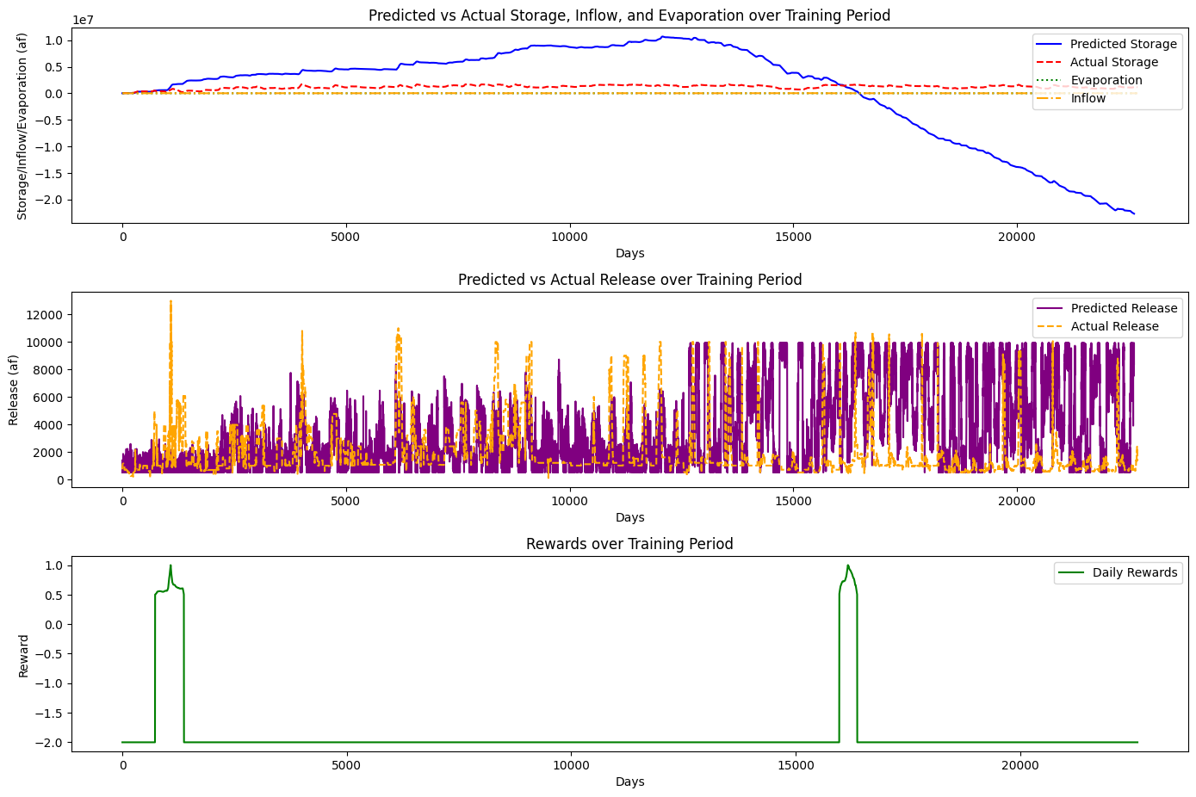
TD3 Optimization Problem

Slide 11
TD3 Optimization Problem
# Define reservoir release and storage limits
navajo_min_release = 250 cfs, navajo_max_release = 5000 cfs
min_storage_af = 500000 AF, max_storage_af = 1900000 AF
# Update storage with current release, inflow, and evaporation
self.current_storage = self.current_storage - release_af + inflow_af - evaporation_af)
# Reward based on release within acceptable range and storage limits
if navajo_min_release <= release_af <= navajo_max_release:
release_reward = 1.0
else:
release_reward = -1.0 # Heavy penalty for out-of-bound releases
# Additional reward for keeping storage within range
if min_storage_af <= self.current_storage <= max_storage_af:
storage_reward = 1.0
else:
storage_reward = -2.0 #penalty for out-of-bound storage
# Total reward
reward = release_reward + storage_reward

Slide 12
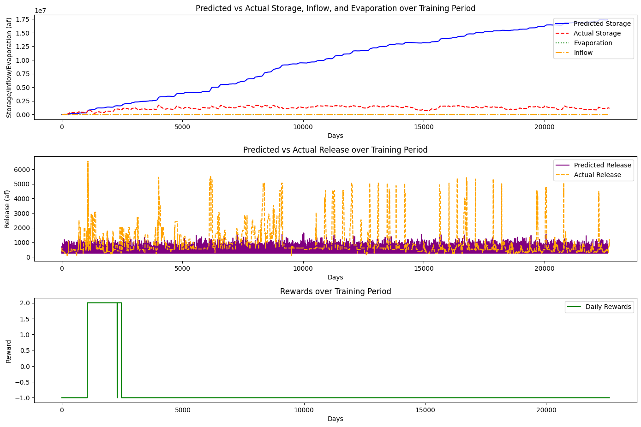
TD3 Optimization Problem

Slide 13
TD3 Optimization Problem- RivWare Constraints
# Reservoir Operational Constraints for Navajo
If Navajo reservoir elevation goes below 5985 ft – NIIP diversion is zero

